Slide 1

DATA ANALYTICS AND VISUALIZATION(24DSB3101)
An Explainable AI Framework for Multimodal Big Data Analytics in Smart Transportation Systems
Batch – 12
2420030554 – Y. Paavana Pranavasri
2420030394 – K. Bhavya
2420030416 – A. Divya Sree
2420030677 – J. Sree Vardhini

Slide 2
Problem Statement:
Smart transportation systems generate large and complex datasets from public transport services, road accidents, and climate/weather conditions.
Existing transportation analytics often examine these data sources independently, making it difficult to identify relationships between transportation patterns, road safety, and environmental conditions.
AI and machine-learning models can provide useful predictions and insights, but complex models may operate as black boxes, making it difficult to understand the factors influencing their predictions.
Therefore, there is a need for an integrated Big Data Analytics and Explainable AI (XAI) framework that can analyze transportation and road-safety data while providing understandable insights for safer and smarter transportation planning.

Slide 3
Project Objectives:
To develop an integrated data analytics framework for analyzing public transport, road accident, and climate/weather datasets.
To identify transportation, road-safety, and environmental trends, patterns, relationships, and risk factors through data analysis and visualization.
To enhance with hybrid ensemble layer using complementary predictive models.
To integrate SHAP, and LIME techniques to predict transportation/road-safety outcomes and provide meaningful explanations of model predictions.
To evaluate model performance and explainability to identify important factors influencing transportation and road-safety predictions and support informed decision-making.

Slide 4
Literature Survey: Papers 1 to 5
Paper | Publication | Key Contribution | Limitations
An Automated Approach for Predicting Road Traffic Accident Severity Using Transformer Learning and Explainable AI Technique (2024) | IEEE Access | Uses Transfer Learning with SHAP for crash severity prediction and identifies important environmental and roadway factors. | Focused primarily on US highway crash data; lacks long-term climate variables.
An Explainable Machine Learning Approach to Traffic Accident Fatality Prediction in Dhaka (2024) | arXiv / Peer-Reviewed Preprints | Uses LightGBM, Random Forest, XGBoost and SHAP to identify major factors influencing accident fatality risk. | Evaluates urban metropolitan crash data without incorporating multi-decade daily rainfall/weather trends.
Enhancing Traffic Accident Severity Prediction: Feature Identification Using Explainable AI (2025) | MDPI Applied Sciences / Computer Science | Uses Random Forest and LIME to provide global feature ranking and local explanations for accident severity. | Relies heavily on static crash characteristics rather than integrating public transport operational feeds.
An Explainable Multi-Task Deep Learning Framework for Crash Severity Prediction (2025) | PMC / Scientific Reports | Uses multi-task deep learning and SHAP to predict fatalities, injuries, and property loss using multiple data sources. | Complex neural network architecture creates high computational overhead for interactive real-time deployment.
Predicting Traffic Accident Injury Severity Using Ensemble Machine Learning Architectures and SHAP Analysis (2026) | PMC / Scientific Reports | Uses ensemble machine learning and SHAP to predict injury severity and explain individual crash factors | Focuses solely on injury severity outcome without integrating public transit flow or weather anomaly metrics.

Slide 5
Literature Survey: Papers 6 to 10
Paper | Publication | Key Contribution | Limitations
Explainable AI Techniques for Interpretable Traffic Prediction Models in Safety-Critical Transportation Systems (2026) | Research Gate/ Transportation Systems | Uses GCN, attention mechanisms, ensemble models, and SHAP to identify important factors in traffic risk prediction. | High dependence on temporal features with limited multi-source data fusion from weather datasets.
A Novel Hybrid XAI Solution for Autonomous Vehicles: Real-Time Traffic Risk & Safety (2026) | MDPI Sensors | Combines machine learning and real-time XAI to provide human-interpretable traffic safety risk explanations. | Designed for vehicle-level edge devices rather than regional smart city dashboard networks.
An Explainable Artificial Intelligence (XAI) Based Driver Fatigue Detection Framework (2024) | IJES / Safety Research | Uses tree ensembles, LIME, and SHAP to provide transparent explanations for driver risk events. | Concentrates on individual driver behavior rather than macro road network accidents and weather conditions.
Uses tree ensembles, LIME, and SHAP to provide transparent explanations for driver risk events. (2023) | IEEE Conference Proceedings | Applies Decision Trees, Random Forest, and XGBoost for traffic accident severity classification. | Functions as a pure black-box model without SHAP/LIME explainability integration.
Big Data Analytics for Climate-Resilient Urban Transportation Networks (2024) | Springer Operations & Transport Research | Uses PySpark, Random Forest, and time-series models to analyze weather data and identify vulnerable transportation corridors. | Lacks an interactive user dashboard for real-time risk simulation and local XAI explanations.

Slide 6
Research Gaps Identification:
Gap 1 – Lack of Integrated Data Analysis:
Existing studies often analyze public transport, road accident, and climate/weather data separately, making it difficult to understand relationships between transportation, road safety, and environmental conditions.
Gap 2 – Limited Identification of Combined Risk Factors:
Existing studies have limited focus on identifying and visualizing transportation, road-safety, and environmental patterns and risk factors together.
Gap 3 – Lack of Explainable AI Integration:
Many transportation AI models focus on prediction accuracy and may operate as black boxes, making it difficult to understand which factors influence their predictions.
Gap 4 – Limited Evaluation of Prediction and Explainability:
Existing research gives less attention to evaluating both model performance and explainability together to determine the most effective approach for transportation decision-making.

Slide 7
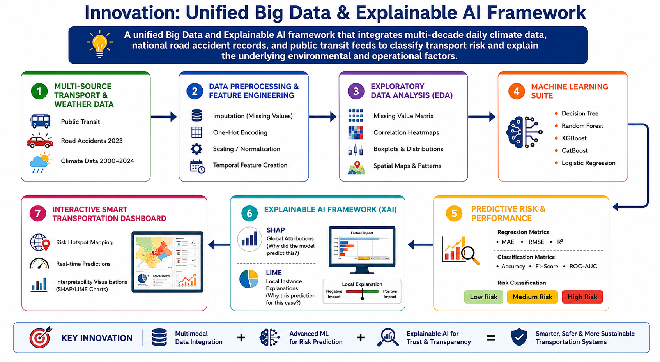
Innovation: Unified Big Data & Explainable AI Framework
Integrates multimodal transportation, accident, and climate data to predict transport risk and explain the environmental and operational factors influencing each prediction.

Slide 8
Feasibility Analysis :
Area | Feasibility Assessment
Dataset | High. Open benchmark datasets available: Public Transport feeds, Road Accidents in India (2023), and Climate in India Daily Weather Data (2000–2024).
Programming | High. Standard Python data science ecosystem (Pandas, NumPy, Scikit-Learn, SciPy).
ML & XAI Libraries | High. Well-supported packages available (XGBoost, CatBoost, SHAP, LIME).
Big Data Processing | High. Efficient handling via Pandas/Dask; scalable to PySpark if data volumes exceed system memory.
Visualization | High. Streamlit or Power BI for rapid interactive dashboard deployment.

Slide 9
Feasibility Analysis :
Area | Feasibility Assessment
Hardware | High. Normal laptop (16GB RAM) or standard free GPU/TPU environments like Google Colab.
Cost | High. 100% open-source software stack and publicly accessible open data.
Timeline | High. Modular phase-by-phase execution easily achievable within a standard semester sequence.

Slide 10
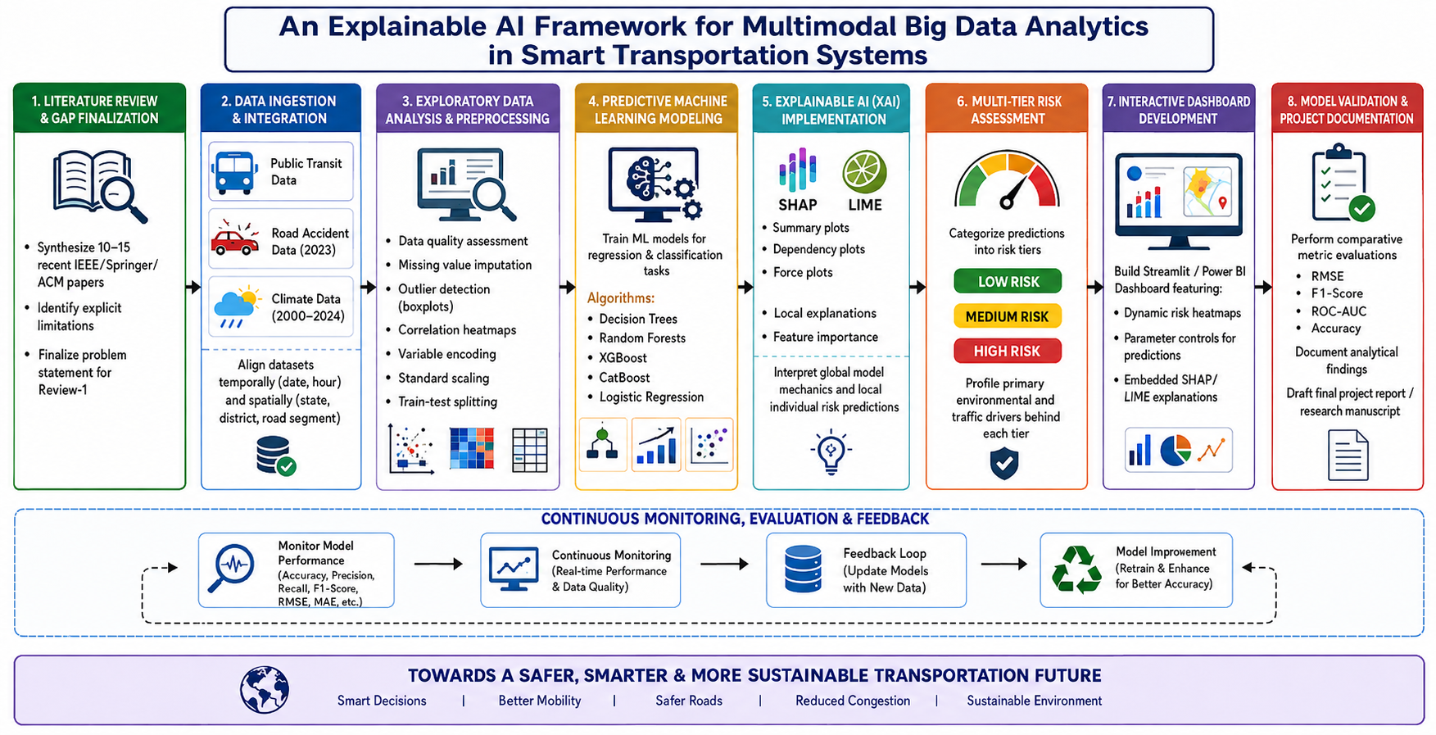
Project Plan:

Slide 11
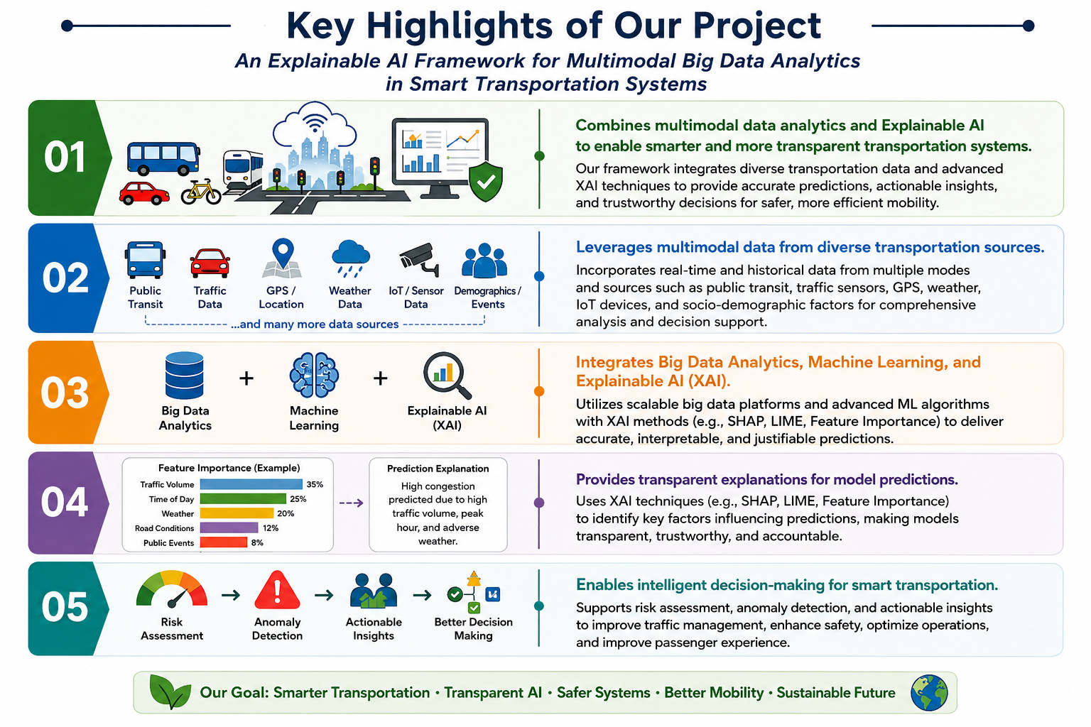
Proposed Work and Its Uniqueness:
- Combines public transportation, road accident, and climate/weather analysis in one integrated system.
- Uses multiple transportation, safety, and environmental factors instead of focusing on a single transportation problem.
- Integrates Big Data Analytics + Machine Learning + Explainable AI (XAI) for smart transportation analysis.
- Provides explanations for predictions, showing which transportation, accident, and environmental factors contribute to the predicted outcome.
- Aims to provide transportation and road-safety insights through interactive dashboards, supporting smarter planning, safer roads, better mobility, and informed decision-making.

Slide 12
References:
[1] Hassan et al. (2025), Application of machine learning in intelligent transport systems: A comprehensive review and bibliometric analysis, Discover Civil Engineering, Springer.
[2] Akin, Canbay & Sagiroglu (2025), A novel geo-independent and privacy-preserved traffic speed prediction framework based on deep learning for intelligent transportation systems, The Journal of Supercomputing, Springer.
[3] Rocco di Torrepadula et al. (2025), Fedflow: A personalized federated learning framework for passenger flow prediction, Machine Learning, Springer.
[4] Alam et al. (2025), A comparative study of machine learning models for taxi-demand prediction using a big data framework, Public Transport, Springer.
[5] Leinonen et al. (2025), Long Short Term Memory Based Traffic Prediction Using Multi-Source Data, International Journal of Intelligent Transportation Systems Research, Springer.
[6] Abdulrashid et al. (2025), An interpretable machine learning framework for enhancing road transportation safety, Transportation Research Part E.
[7] Abdulrashid et al. (2025), Transport behavior and government interventions in pandemics: A hybrid explainable machine learning for road safety, Transportation Research Part E.
[8] Chen et al. (2026), From Prediction to Prevention: Using Text Mining and Explainable Machine Learning for Urban Bus Accident Analytics, Risk Analysis.
[9] Abid et al. (2026), Improving road safety in smart cities using machine learning techniques, Scientific Reports.
[10] Pathak & Chatterjee (2026), Artificial intelligence, machine learning, and deep learning in intelligent transportation systems: A review for smart cities and sustainable mobility, International Journal of Applied Resilience and Sustainability.

Slide 13
Thank You

